Slide 1
LENDING CLUB CASE STUDY SUBMISSION
Name: Ankur Pandey
Name: Priyanshu

Slide 2
Business Objective
As lending company we want to analyse the past loan data and come up with factors that are precursors for a loan default.
This analysis address two types of risks:
If the applicant is likely to repay the loan, then not approving the loan results in a loss of business to the company.
If the applicant is not likely to repay the loan, i.e. he/she is likely to default, then approving the loan may lead to a financial loss for the company
So by analysing data we want to come up with driving variables/factors that can indicate loan defaults. The company can utilise this knowledge for its portfolio and risk assessment.

Slide 3
Dataset Analysis
Check for missing values and Nan values in rows/column's
Ideally, remove column's having more than 90% missing values
Ideally, remove the row having more than 5% missing values
Convert date column’s to date time as Derived Metrics
Bin the variables across discrete categories
Univariate analysis
Segmented univariate analysis
Bivariate analysis
Bivariate analysis across categorical variables

Slide 4
Analysis Approach
Following variables were considered for this case study analysis:
Loan Purpose
Loan Grade
Home Ownership
Loan Issue Year
Loan Sub-Grade
Verification Status
Interest Rates
Installment Amount
Annual Income
Employment Length
Loan Amount
DTI (A ratio calculated using the borrower’s total monthly debt payments on the total debt obligations)
Earliest Credit Line
Customer Address state
Number of open credit lines

Slide 5
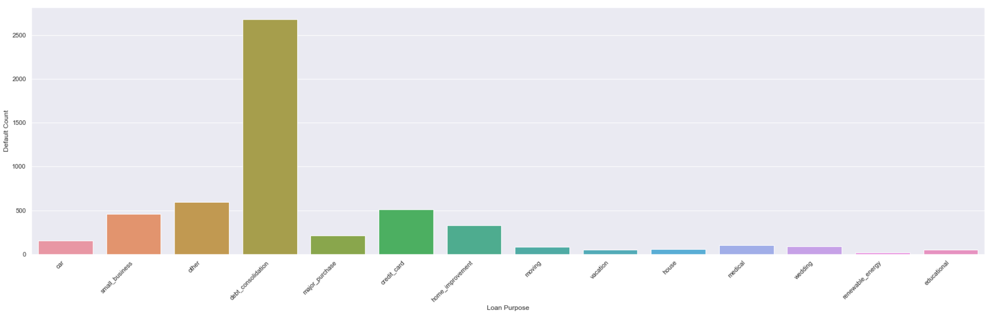
Univariate Analysis: loan purpose
Observations: This suggest debt consolidation have major defaults over 2500 loan applications. Which is significantly higher than the rest of the loan purposes

Slide 6
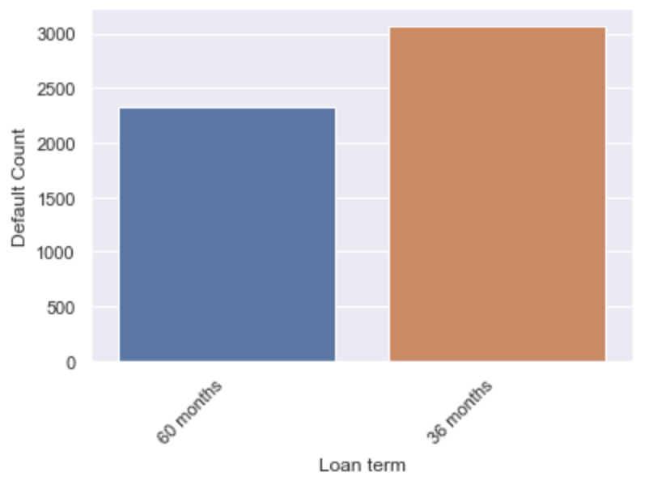
Loan Term
Observations: Its clear from the graph that 36 months loan term have more default rates that 60 month but difference is not much.

Slide 7
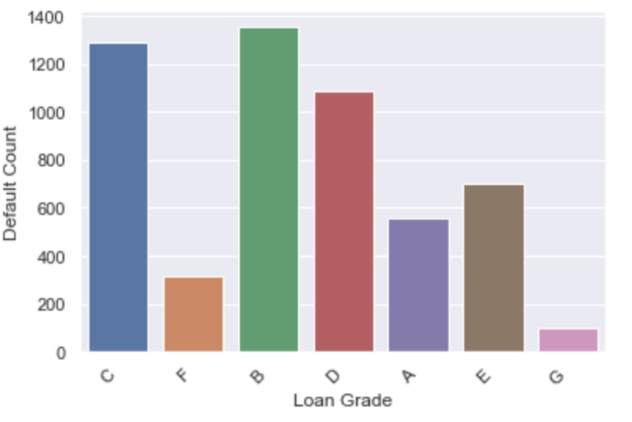
Loan Grade
Observations: This suggest Loan Grade B,C and D are most defaulted loan grades

Slide 8
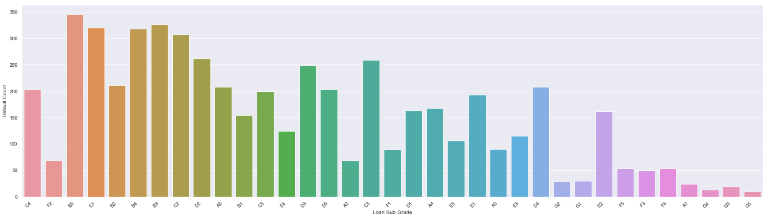
Loan Sub Grade
Observations: This observation confirm that observation in previous Grade analysis except few subgrades Loan Grade B, C and D have more loan defaults number.

Slide 9
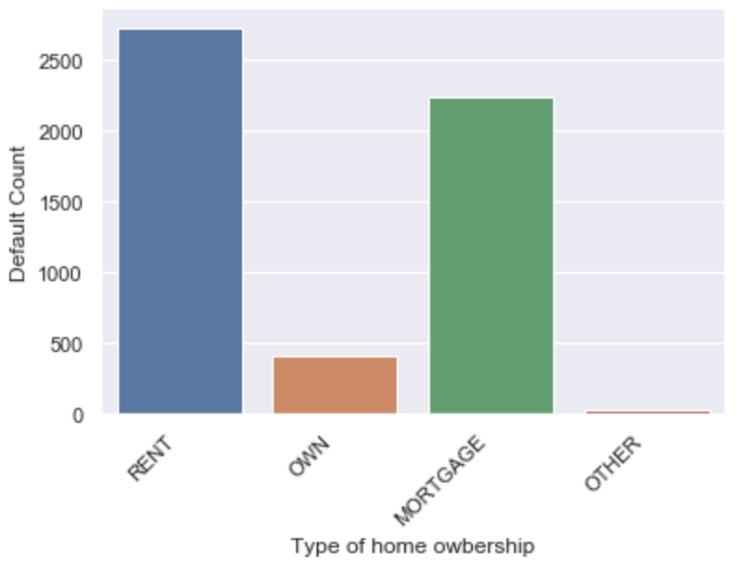
Home Ownership
Observations: This suggest people living on rent have over 2500 loan defaults and is followed by Mortgage which is close to 2200. Other types like OWNED property and “others” are NOT that significant.

Slide 10
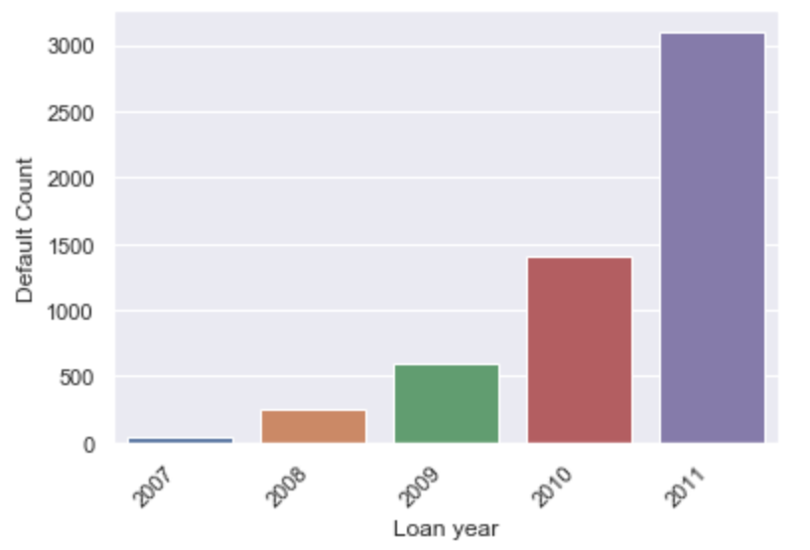
Loan Issue year
Observations: This suggest loan issued in year 2011 were defaulted more than any other year in past. The trend is increasing year by year.

Slide 11
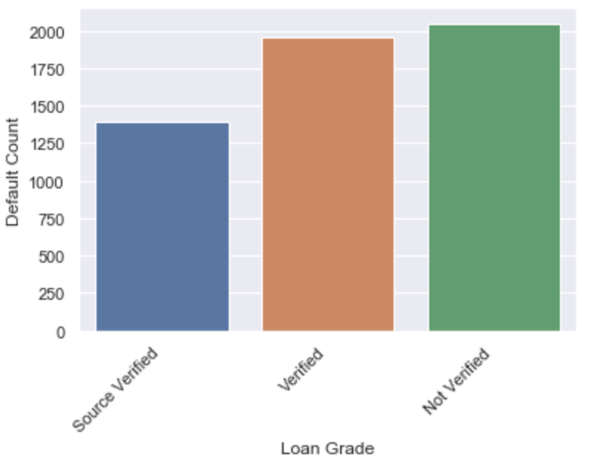
Verification Status
Observations: Graph suggests the loan which had source verified have least number of defaults as compared to verified or Not verified applications. However the difference isn’t significant.

Slide 12
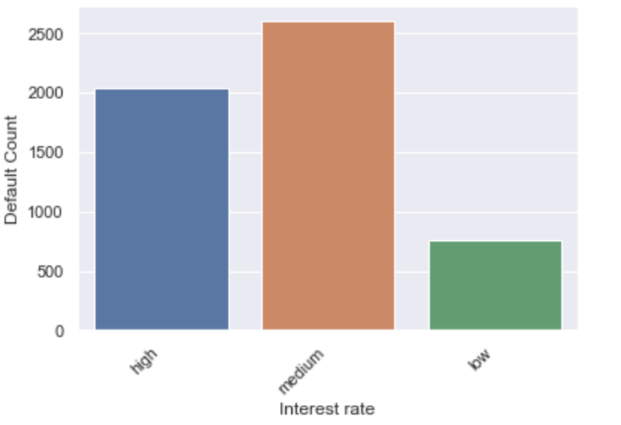
Interest Rate
Observations: Graph suggests that loans with medium rate of interest (10.1-15%) have more defaults above 2500

Slide 13
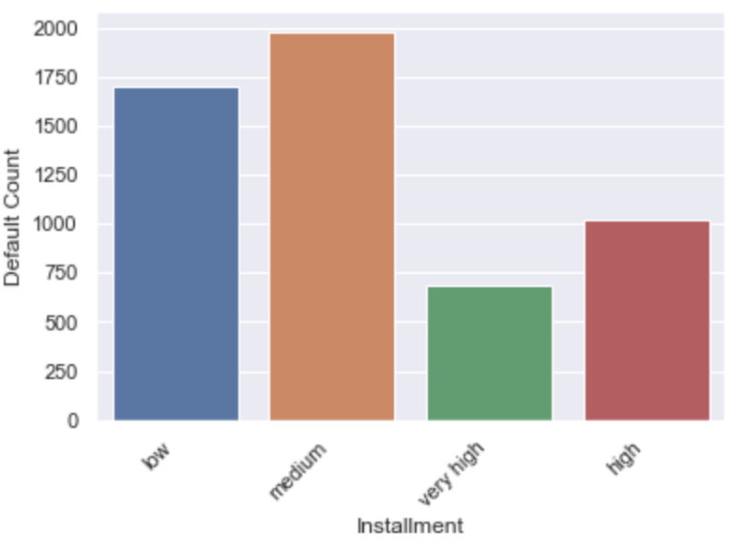
Installment Amount
Observations: This graph suggests EMI of medium category ($200 - $400) and low category (less than $200) have more default rate.

Slide 14
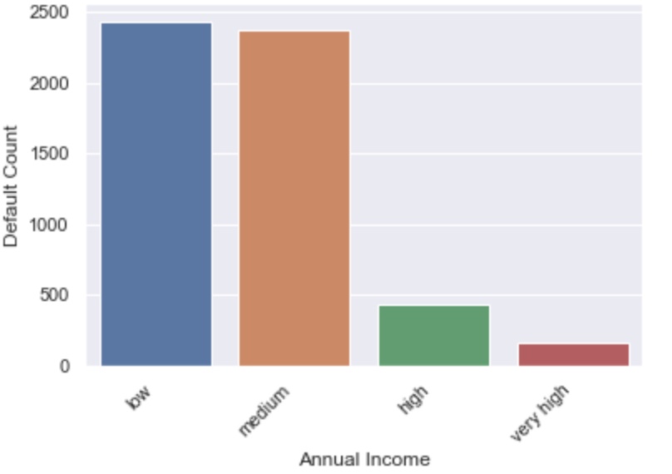
Annual Income
Observations: We can observed that people having low ( less than $50000) and medium ($50000 to $100000) income range are high in defaults.

Slide 15
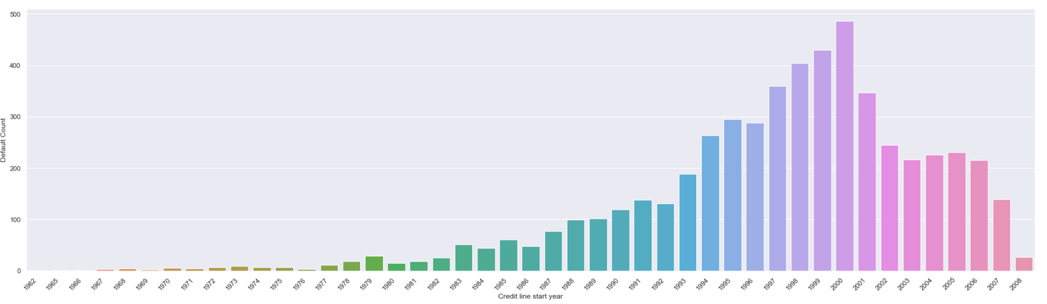
Earliest Credit Line
Observations: We can observed that applicants having credit line started after 1993 have defaulted more and this trend reached its peak in year 2000. While after that data shows a serious decline in number of defaults.

Slide 16
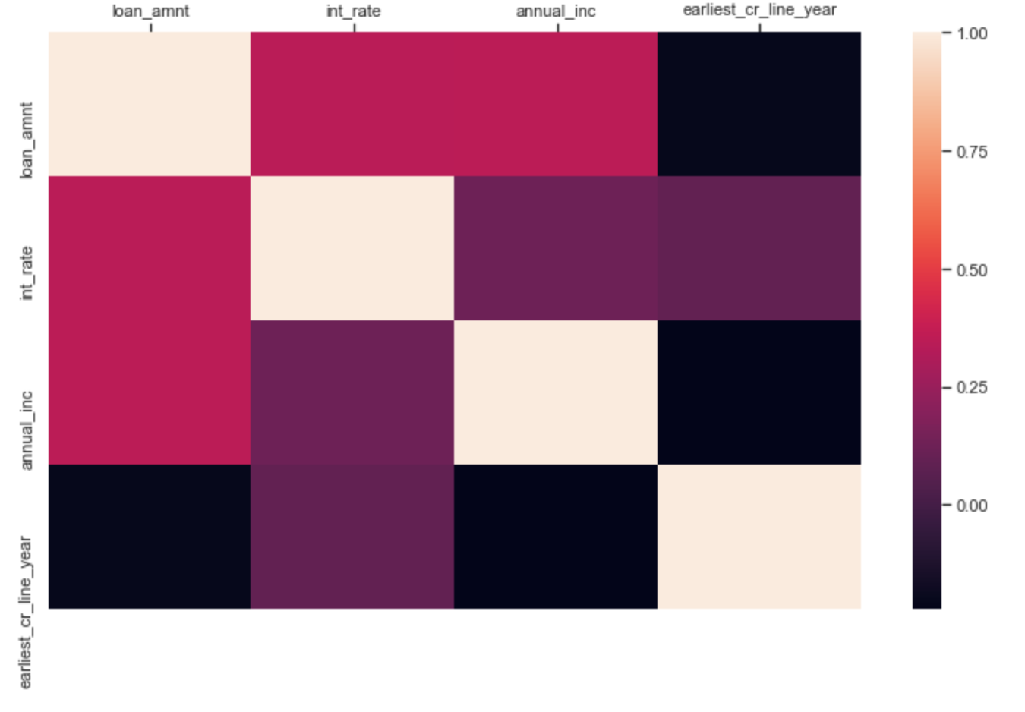
Bivariate Analysis: Correlation
Observations:
Annual income and Loan amount have a negative
correlation.
Annual income, Loan amount and Interest rate are
Somewhat correlated to each other around 0.34.

Slide 17
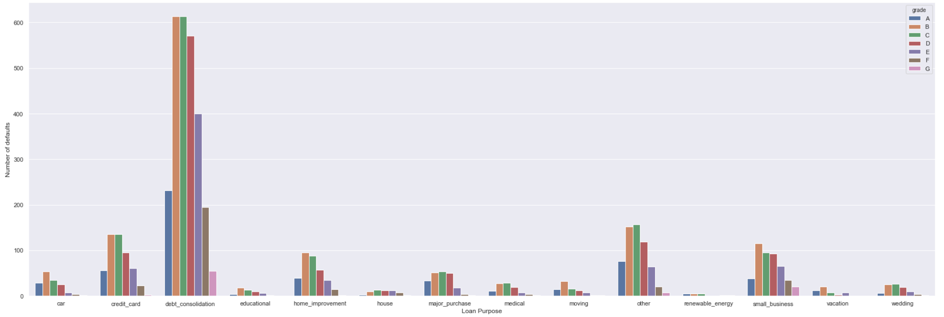
Grade Vs Purpose
Observations: From univariate analysis of “purpose” we observed that “debt_consolidation” have higher no. of defaults.
Similarly in grade’s univariate analysis, we observed loan grade B, C and D types have more defaults.
While comparing these two we can confirm the observation that loan grade B, C and D have higher loan defaults comparing with other grade in almost all
loan purposes.

Slide 18
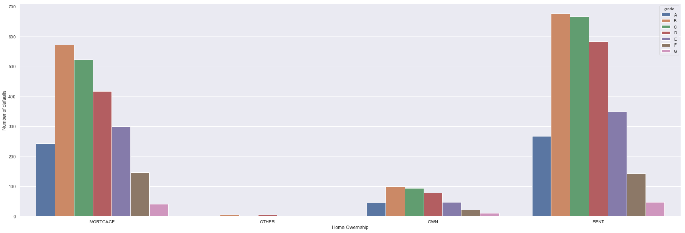
Grade Vs Home Ownership
Observations: From univariate analysis of home_ownership we observed that “rent” and “mortgage” have higher no. of defaults.
Similarly in grade univariate analysis, we observed loan grade B, C and D types have more default.
While comparing these two we can confirm the observation that loan grade B, C, and D have higher loan defaults comparing with other grades in almost
all type of “home_ownership”.

Slide 19
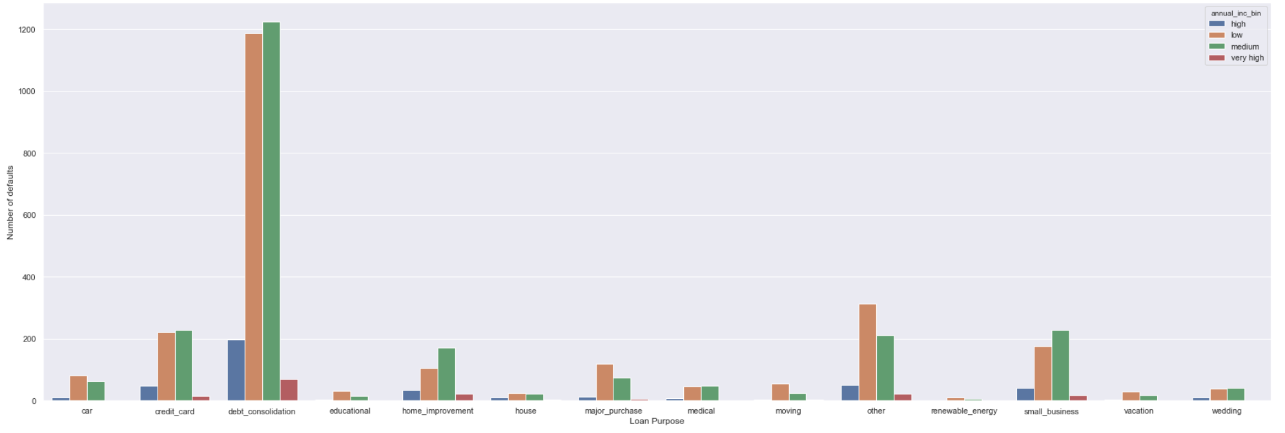
Purpose Vs Annual Inc.
Observations: From univariate analysis of purpose we observed that “debt_consolidation” is higher no. of default.
Similarly for annual_income we observed that people having low (less than $50000) and medium ($50000 to $100000) income range are high in defaults.
While comparing these two we concluded that this observation is valid for all types of loan purpose categories.

Slide 20
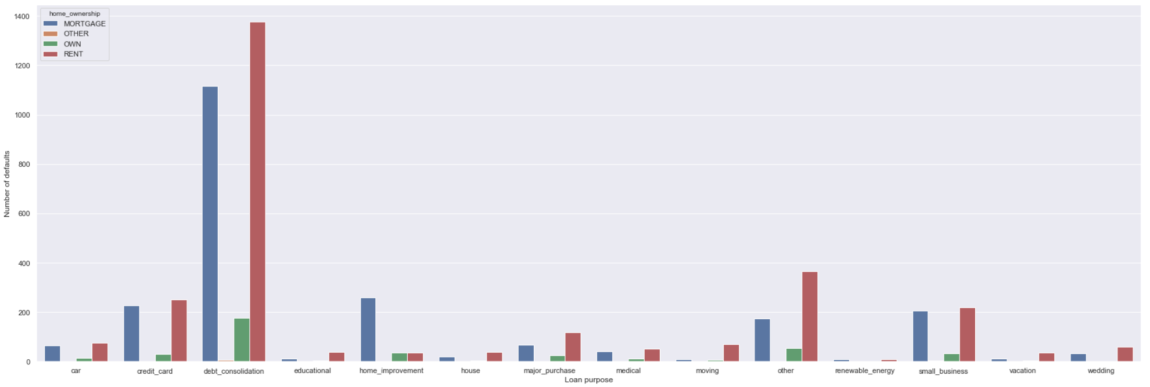
Purpose Vs Home Ownership
Observations: From univariate analysis of purpose we observed that “debt_consolidation” is higher no. of defaults.
Similarly for “home_ownership” we observed that “rent” and “mortgage” have higher no. of defaults.
While comparing these two we can confirm the observation that expect “home improvement” type of loan purpose, loans on RENT type of ownership
is higher in number of defaults followed by mortgage type.

Slide 21
Conclusions
The major driving factors/indicator for loan defaults:
1. Loan Purpose
2. Income level
3. Loan Grade
4. Home ownership
5. Instalment
6. Interest rates
Minor variables that affect default rates are:
1. Loan Term
2. Loan Amount
3. Employment length
4. earliest credit line
5. Number of credit lines
6. Verification status

Slide 22
Conclusions
A red flag can be raised if :
Loan properties:
Loan Purpose is Debt consolidations
Loan Grade is B, C and D
Installment is less than $400
Interest Rate is 10-15%
Applicants properties:
Income level is less than $100000
Applicant is on Rental or mortgage property
Earliest credit line is after 1992 but before 2008

